Slide 1
P096:
White Light Interferometry
Abhishek Iyer (112401002)
Hemanth Kashyap Gundamaraju (112301009)

Slide 2
Objectives
To simulate White Light Interferometer by using randomly generated CSV file of heights and generating interferograms that might form using the resulting heightmap.
To create a functioning White Light Interferometer and use AI and Deep Learning algorithms to convert the interference waveform obtained from the interferometer to a 3-D Surface Height Map of the sample surface.

Slide 3
Timeline / Steps
Create a program to generate arbitrary height maps
Create a program to convert those height maps into corresponding interference pattern
Using 1 and 2, create a large dataset for training the AI Model
Optimize and fine tune the model until it can generate the corresponding height map when fed input of an interference waveform
Create a prototype White Light Interferometer to generate interference waveforms for a given sample surface
Further refine the Model to account for any imperfections such as dust/camera aberrations etc. in real world usage
Using the AI Model, find out the height variations and surface topography of the sample surface

Slide 4
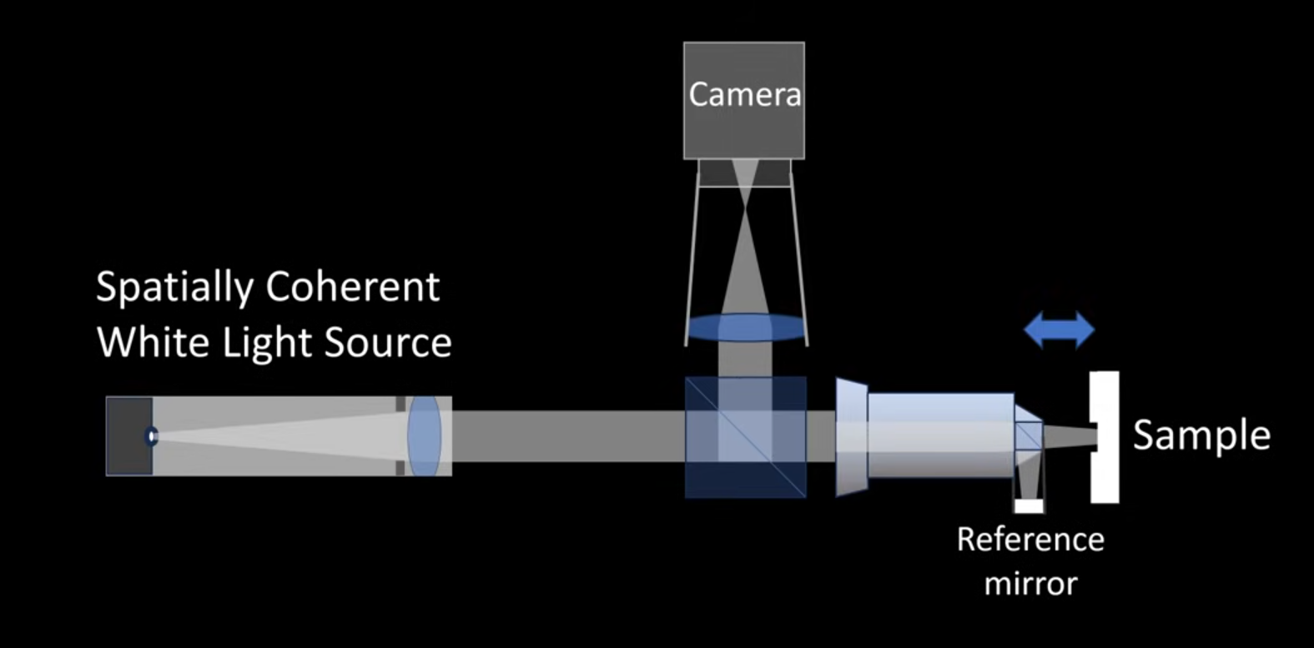
Working Principle
White light has a short coherence length, allowing it to generate clear, localized fringes only over a small depth of focus.
We use a pinhole along with a lens to make the white light spatially coherent.
The variations in path length caused by the surface topography of the sample surface cause interference between the reflected and reference beams of light, giving rise to interference patterns.
Mirau Objective

Slide 5
Underlying Physics
Height variations in the sample surface lead to an interference pattern being generated due to phase differences arising from path difference of the reflected and reference light beams.
The sample surface is scanned across, generating many fringes
At each point, the position of maximum fringe contrast (coherence peak) is recorded. This indicates the point where the two beams have equal optical path length.
The vertical position of this coherence peak gives us the height of the sample at that point

Slide 6
Equipment / Materials Needed
Mirau / Michelson Objective Lens
Beam Splitter
Broad Band Emitter (White LED)
Achromatic Lens (to focus the camera onto the sample)
Optical Rails + Mounts (Very precise)
CMOS Camera
Piezo Activator (To scan along the sample)

Slide 7
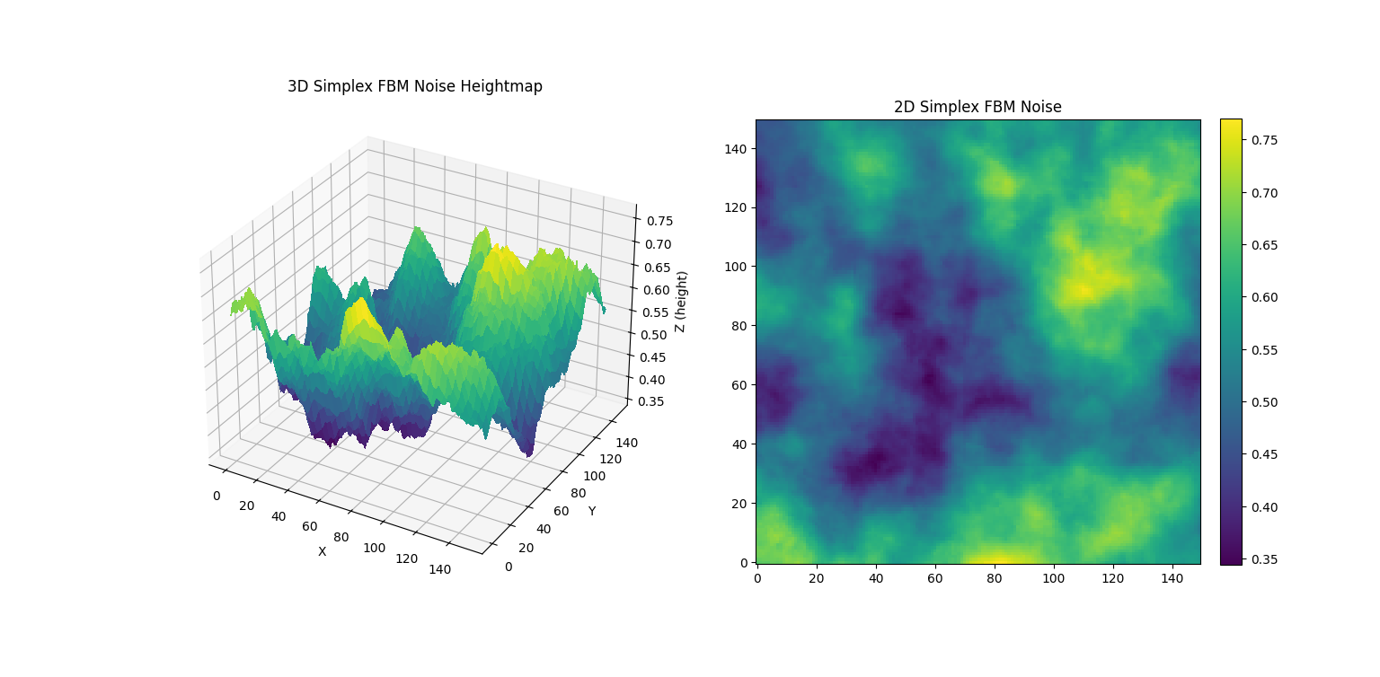
Step 1: Heightmap generation
Tested various noise generators:
Worley Noise: Too regular
Perlin Noise: Worked well
Simplex FBM Noise: Improved on efficiency and randomness over Perlin
Created a Python program to generate random, arbitrary height maps using Simplex Noise Fractal Brownian Motion (Simplex FBM)
The left image is the heightmap visualized in 3D
The right image is the 2D projection of the heightmap with colours representing depth

Slide 8



Step 2: Creating a WLI Simulator
Imported the heightmap from CSV.
Scaled the data into nanometres for optical relevance.
Defined simulation parameters: wavelength ( ) 600 nm, coherence length ( ) 100 nm, and mirror scan range (s) -300 to 300 nm.
Computed the optical path difference (OPD) using: OPD=2(z−s)
Generated intensity values using cosine interference with a Gaussian coherence envelope.

Slide 9
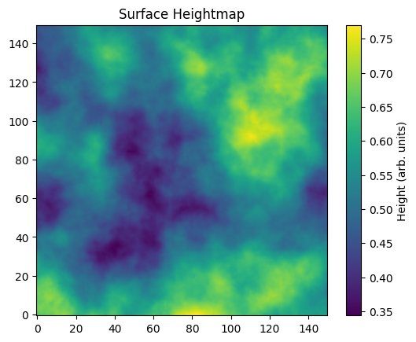
Input Surface Data & Heightmap Visualization
We plotted a 2D heightmap loaded from heightmap.csv to verify the imported data is correct before simulation.
Key takeaways:
Colour corresponds to height variation.
Surface features influence the phase and fringe structure in later steps.
Ensures the dataset is correctly structured and scaled.

Slide 10
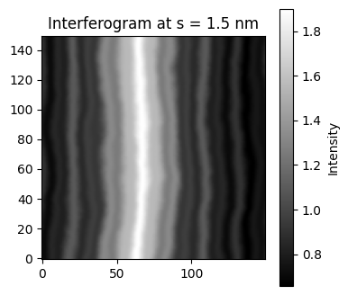
Simulated Interferogram at Fixed Reference Position
Plot shown:
One frame of the simulated interferogram: I[:, :, mid_index]
Shows how interference appears for one mirror position in the scan.
Areas with varying height show local changes in fringe spacing.
Visible fringes correspond to areas where the OPD is close to a multiple of the wavelength.
Fringe contrast is highest near the coherence peak.
Structure of fringes reflects underlying surface gradients.

Slide 11
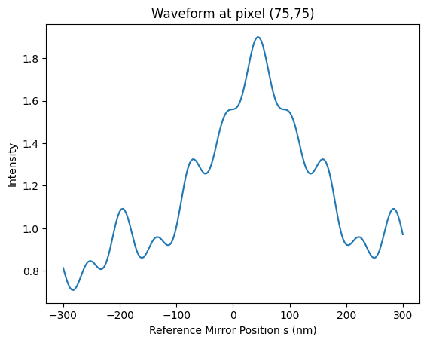
Pixel‑Level Behaviour
Produces a sinusoidal signal modulated by a Gaussian‑like envelope.
The location of maximum envelope intensity corresponds to the surface height at that pixel.
Used later for height reconstruction.

Slide 12
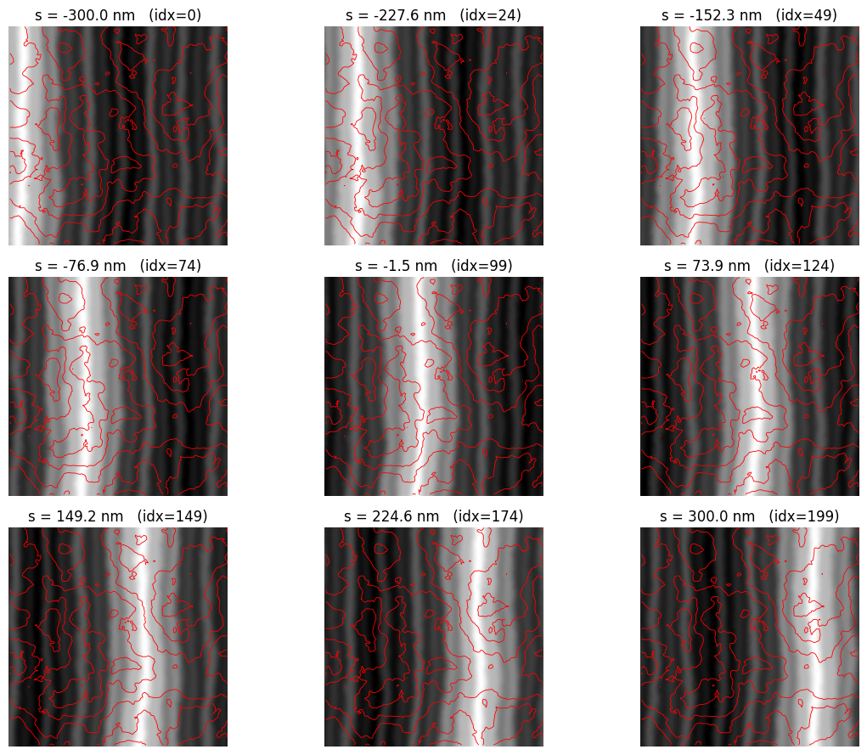
Global Trends
Mean intensity vs scan position confirms expected coherence peak behaviour.
Frames across the scan show fringes appearing, strengthening, then fading.
The simulation output aligns with expected white‑light interferometry response.

Slide 13
Issues Faced: Fringe Pattern was not shown
The initial simulation without tilt produced output, but no visible spatial fringe pattern was present.
To generate observable interference fringes, a linear phase tilt was added to the reference beam.
After applying tilt, the interferogram displayed clear, structured fringes, making the behaviour easier to interpret and validate.
Tilt helped confirm that the simulation was working correctly, and that interference was occurring as expected.
The final simulation includes tilt, and it remained part of the model because it improved fringe visibility and interpretability.

Slide 14
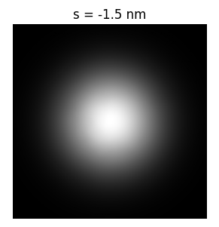
Interferogram Without Tilt vs With Tilt
Without Tilt:
With Tilt:

Slide 15
Thank you!

